Slide 1
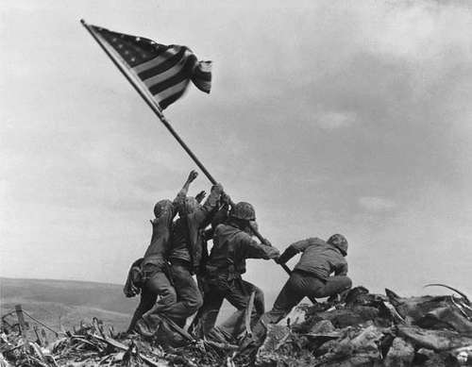
Effects of World War II on Brazil
Name
Institution

Slide 2
Introduction
Brazil was more active in World War II than in the previous War.
The navy played a crucial role in the battle at around 1942.
Initially, Brazil was neutral and traded with both the Axis and Allies.
Later, the United States government forced the country to join the Allies.
The United States and Brazil formed a joint defense commission.
The two groups of militaries became one strong team and even traded together.
Some years later after Brazil joined the Allies, a decision to create diplomatic relations with other countries like Japan and Italy was made.
After the Atlantic battle, Brazil suffered most because both civilians and some Navy soldiers were killed.
The Brazilian Navy worked in conjunction with the Allies to protect the ships and territories.

Slide 3
Effects of World War II on Brazilian economy
World War II brought more harm than benefits in the Brazilian economy.
Both Brazil and the United States suffered almost equal loses in the economy.
However, after the War, the country was able to restore the economy faster than other nations like England.
After World War II, the economic status of the country transformed rapidly.
Before the war, only 31.1% of the total population lived in town. After the war, about 75% of the citizens had already migrated to cities.
The battle resulted in a decline in the total gross national product. The rate dropped from 28% to 11%.
Later in the nineteenth century, Brazil was able to increase the GNP from below 20% to more than 39% (Frank, 2018, P111).
The government worked hard to restore production of the domestic market.

Slide 4
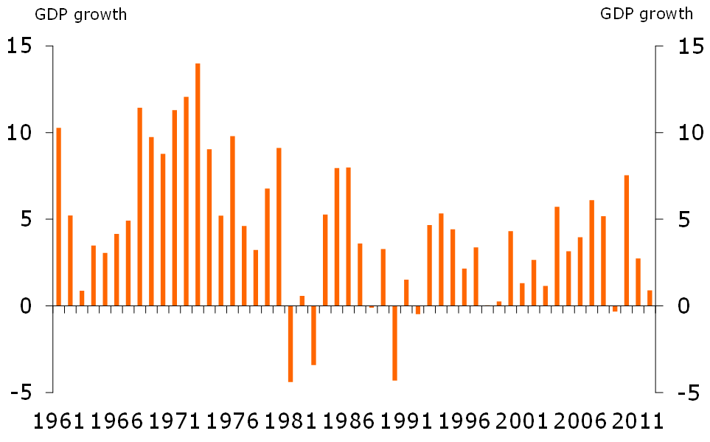
Brazil economic growth
During the war and from around 1980 to 1990, the country suffered inflation, and economic growth was low.
Later, the government established some programs and economic initiatives that helped in boosting the financial position.
Plano Real is one of the plans that was introduced to support the economy.
The strategy was successful because it helped in stabilizing the financial position of the country within a short period.
The real plan worked on eliminating inflation and succeeded after several failed attempts in the past years.
In 1998, the country received 41.5 billion Dollars from international support program, which played a crucial role in boosting the economy and supporting investors.
Once the strategies were implemented correctly, the country joined the global economy and development programs.

Slide 5
Effects of World War II on Brazil’s politics
During the first phases of the war, Brazil was neutral.
Later, the country was influenced by the United States and started supporting the Allies.
After the war, Brazil’s division worked in the allocation of provinces. Later, the secretary of the War was in charge of providing orders to the military and other leaders.
A military coup took place, and Vargas ruled with dictatorship until 1945, when the country broke ties with the Allies in the War.
The country embraced democracy. However, there was social instability, and the economy was not stable.
The military took over again in 1964, and General Humberto took over leadership from the previous leader. The existing political parties were abolished, and the military controlled the government until 1985.
A new president was elected and was the first non-military president in the country.

Slide 6
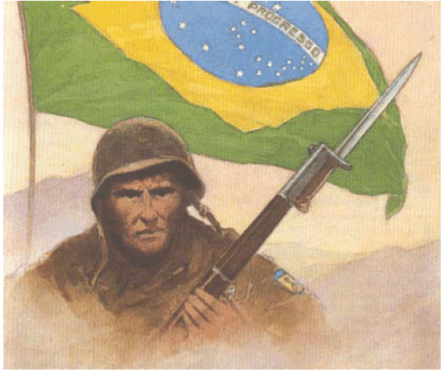
Political changes in Brazil
The first presidential elections were held for the first time, and Fernando was elected.
Later, the country started experiencing changes due to mismanagement of resources.
Fernando was accused of being corrupt, and after some time, he resigned from office, and his vice president tool over to complete the term.
The nation was transformed, and the transition worked well.
A civilian government that began in 1985 led to changes in the political positions of leaders.
A democratic process started, and some changes were established in the constitution.
All the citizens were provided a right to vote.
In 1987, an assembly was established to debate about the formation of a new constitution (Barbosa, 2017, P118).
The National Congress approved a final copy of the laws in 1988. Since then, the National Congress contains the legislative powers.

Slide 7
Effects of World War II on social factors
After the world war, the capital of Brazil changed from Rio de Janeiro and was named Brasilia.
From 1950 to 1960, the military started changing the domestic affairs of the country.
The forces began to work together in fighting the enemies.
A second phase of the revolution was established, and the target was to equip civilians and the militaries with knowledge for performing advisory functions.
The United States of America started urging the nations in South America to protect their territories.
The military-led to a division of some sections and groups of people in the country.
Since 1985, Brazil government has been struggling in resource allocation for different classes of people (Lavinas, 2017, P628).
After the war, the economic potential of the country has been attracting tourists and investors.

Slide 8
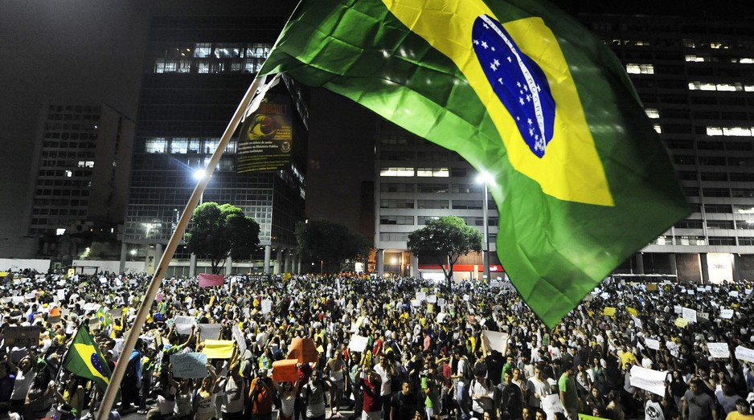
Human development after War
After the war, Brazil is among the countries that were able to empower the citizens and support them in economic growth.
Brazil is ranked among the top countries performance index, with the wealthiest people earning 42.7% of the total income in the nation.
Some metropolitan areas in the country are occupied by the poor.
Slums and remote areas also contain a significant number of low-income earners.
When the country started a democratic system, the government has been allocating some cash to them.
Government organizations also hold campaigns to educate the community on the need for education.
A recent government administration has managed to reduce the poverty level by providing employment.
Reorganization of the government and economic affairs after the war helped the country in working hard towards achieving the levels of developed countries.

Slide 9
Conclusion
Participation of Brazil in World War II helped in the revolution of politics and social-economic factors.
The leaders learned lessons from experience and were able to benchmark the country’s potential with other countries.
Democracy in the country has contributed to economic growth and political stability since the end of the War.
From the performance records of the country, Brazil managed to restore more of its activities after the war. Compared to other countries in the United States, Brazil is led to economic development after the financial crisis.
The War enabled Brazil to mingle with other countries like America, and they created a good relationship.
The ability of Brazil to create social relations with other countries has contributed to the achievement of globalization standards and high economic standards.

Slide 10
References
Frank, A. G. (2018). The development of underdevelopment. In Promise of development (pp. 111-123). Routledge.
Barbosa, L. P. (2017). Educação do Campo [Education for and by the countryside] as a political project in the context of the struggle for land in Brazil. The Journal of Peasant Studies, 44(1), 118-143.
Lavinas, L. (2017). How social developmentalism reframed social policy in Brazil. New Political Economy, 22(6), 628-644.

